Slide 1
Christ Church CEP Primary Academy

Slide 2
Did you know the school has a plan to make us a better school?
Its called a school development plan.
The school council have decided we would like to help make the school better as well.
Will you help us?

Slide 3
Helping the school get better and better.
We want to celebrate children who are good learners.

Slide 4
What is a good learner?

Slide 5
Good Learners …….
Have a great attitude!
Smile
Can do
positive

Slide 6
Good Learners …….
Persevere
Keep going
Never give up
Try again

Slide 7
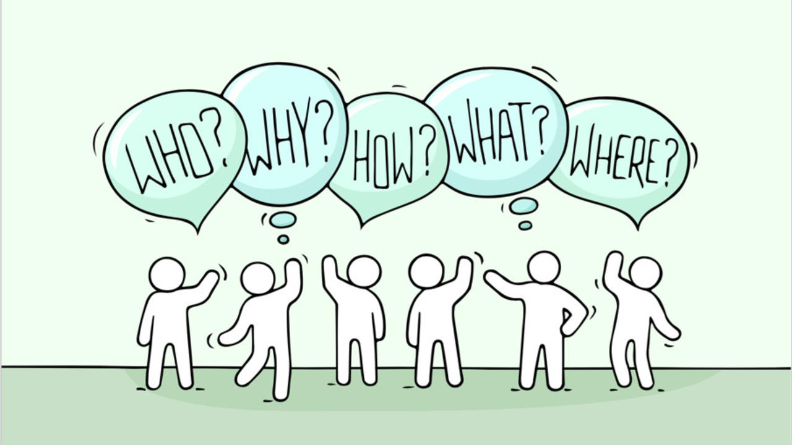
Good Learners …….
Ask questions!

Slide 8
Good Learners …….
Work together and share ideas!

Slide 9
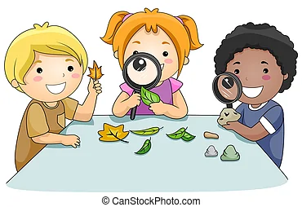
Good Learners …….
Observe !

Slide 10
Good Learners …….
Listen !

Slide 11
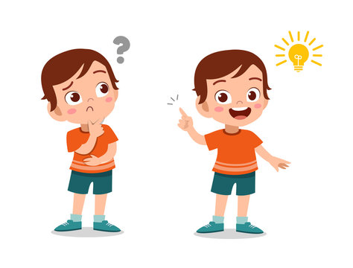
Good Learners …….
Say “I wonder” and “What if”

Slide 12
Do you think you can be a good learner?

Slide 13
We are going to be coming to your classrooms and watching to see who is being a good learner.
If you’re a good learner you will receive a special reward from us, the student council.
We want to say thank you for helping us make the school even better than it already is.
If you have any ideas on what else we can do to improve our school please tell your class student council representative.

